Slide 1
Rekindling & Harmonizing the Vision of the WWW
Chapter 1
WWW Training Manual Vol. 3

Slide 2
Introduction
Every vison needs constant rekindling to be ultimately fulfilled.
Kingdom visions come under seasonal attacks that need regular divine re-invigoration
The Vision of WWW (scriptural marching orders of the move): Jeremiah 9:17-21
To “Rekindle” means:
  To revive a thing/process
  To et a fire burning again
  To increase the intensity/focus
  To re-fire seal/interest
  To push with greater vigor

Slide 3
Descriptions of the Move
A Prayer Movement
A Global Army of Gatekeepers
A Non-Denominational Force
A Company of God’s Prophetic Trumpeters
A Company of Divine Errand Girls
Facilitators of God’s Work Globally
Wombs for the Man-Child Company
Prophetic Legislators
Instruments of Reconciliation
Repairers of Old Waste Places
A Company of Women to Spice the Church
A Company of ordinary Women doing Extra-Ordinary Things
A Company of Weak Things Manifesting Divine Strength

Slide 4
Breaking down the mandate of www
Consider who a WW is
Call for the WW from all the nations
Send for skilled WW
Prompt them to make haste
Ask them to “take up a wailing for us”
Engineer their eyes to run down with tears
Teach your daughters wailing
Teach your neighbours lamentation
Adopt the “Us” approach with teamwork as your modus operandi

Slide 5
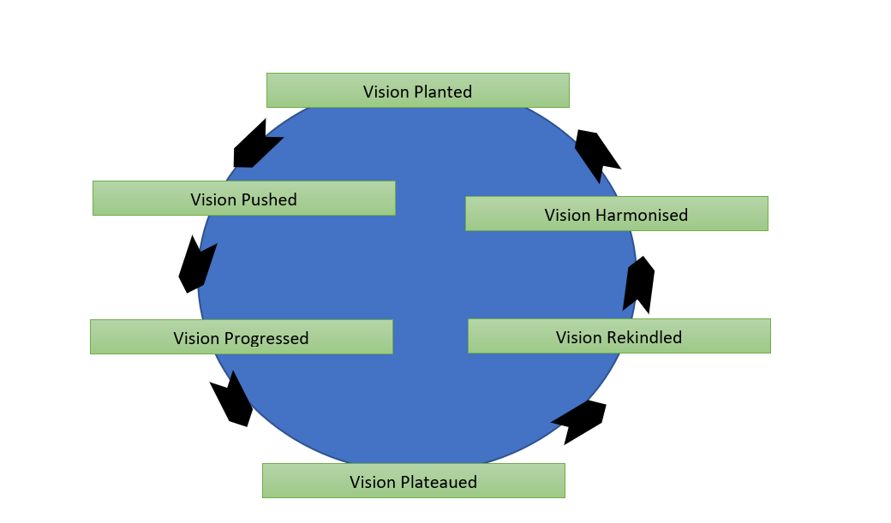
The Nature of Vision

Slide 6
How to Rekindle & Harmonise the vision of www?
Review your original foundation
Revisit and recount your history
Constantly retreat to renew your strength
Go back to your first love
Deliberately and regularly seek for fresh direction
Fresh direction based on the seven-mountain prophecy
Set new SMART goals (Specific, Measurable, Attainable, Realistic, Time-based)
Count the cost afresh
Submit yourself to the Lord for divine pruning

Slide 7
Why is pruning necessary for the work?
To create beauty and balance in the growth of a plant
To aid the development of fresh foliage and branches
To motivate plant vitality, vigor and rejuvenation
To reduce and prevent disease in the plant
To encourage resistance to plant infection and improve plant health and safety
To provide conditions for the harvest of more qualitative and quantitative fruits
Enhance penetration of sunlight into the interior parts of the plant and stimulate the growth points of plant into action
John 15:1-2 “I am the true vine, and my Father is the gardener. 2 He cuts off every branch in me that bears no fruit, while every branch that does bear fruit he prunes[a] so that it will be even more fruitful.

Slide 8
What can a rekindled and harmonized vision do for the new phase of the work of www?
Stimulate greater focus
Release divine provisions
Preserve the visionary
Establish new relationships
Secure destiny in eternity
Enhance greater time management
Guarantee vision fulfilment
Habakkuk 2:2-3 “Then the Lord replied: “Write down the revelation and make it plain on tablets so that a herald may run with it. 3 For the revelation awaits an appointed time; it speaks of the end and will not prove false. Though it linger, wait for it; it will certainly come and will not delay.

